Slide 1


MCAS Miramar Environmental Management
Environmental Training (Initial and Annual Refresher)

Slide 2
Air Emissions, Stormwater, Hazardous Waste, Universal Waste, E-Waste, Recycling, Reusable shop towel Program just to name a few.
MCAS Miramar is regulated by Federal, State, Local, Navy and Marine Corps environmental policies to protect the local environment and preserve it for future generations.

Slide 3

Environmental Management System

Slide 4
An EMS is an approach that integrates environmental considerations into our mission activities.
It’s nothing more than our environmental business plan
Definition

Slide 5
Why an EMS?
To protect human health and the environment for our and future generations of Marines
Increases efficiency and reduces cost
Improves relationships with surrounding communities
Reduces risk to the mission, caused by environmental issues
Assists in maintaining and improving the quality of our environment
Maintains readiness by protecting training environments
Protects the health of Marines, Sailors, Military Members, Civilians, Contractors, their families and surrounding communities from the environmental impacts associated with Marine Corps activities.

Slide 6
EMS Example
Practice: Aircraft Fueling or Vehicle Fueling
Aspect: Uses hazardous material and generates hazardous waste
Impact: Hazardous material/waste can leak or spill and pose serious risk to human health & the environment
Practice Controls: Adhere to SOP’s, properly store hazardous materials/waste, use PPE, have spill equipment on hand

Slide 7
Pollution Prevention

Slide 8

Reduce, Re-use, Recycle
      Reduce purchases to only what you need and reduce more toxic chemicals if possible
      Reuse or repurpose materials rather than disposing of them
      Recycle plastics, metals, paper, cardboard, etc.
      Utilize white recycling bins for comingled recyclables or trailers for cardboard

Slide 9
Recycled Materials/Products
  Purchasing printer paper, toner cartridges, toiletries, etc. made from recycled materials
  Participating in recycling programs and not throwing recyclables in the refuse trash cans
Energy Efficient Products
  Energy Star appliances, low energy light bulbs
Alternative Fuels & Vehicles
  Biodiesel, electric vehicles, hybrids
Bio-Based Products
  Commercial/Industrial products that use bio materials as opposed to manufactured/synthetic materials
  Reduces hazards in manufacturing processes

Slide 10
Environmentally Preferable Products
  Have lesser or reduced effects on health or the environment
Non Ozone Depleting Substances
  Use non ozone depleting products when possible in applications such as refrigeration chemicals, cleaning solvents, fire suppression agents, aerosols, adhesives, paints, etc.
Priority Chemicals
  Reduce amounts of cadmium, lead, mercury

Slide 11
Electronics (E-Waste)
  Fastest growing waste stream in the country due to constant upgrades of electronics (I-phone ?)
  Anything that contains a circuit board or plugs into an electrical outlet: computers, monitors, phones, light bulbs, toner cartridges, DVD players, remote controls, etc.
  Recyclable for the valuable materials used
  Is also toxic due to the materials used,
    PCB’s, Arsenic, Antimony, Nickel, Beryllium, Copper, Zinc, Mercury, Lead
  When improperly disposed of chemicals and elements can leach into waterways causing birth defects, cancer, mutations and death

Slide 12
Ways to reduce pollution and environmental costs:
Utilize station Hazardous Materials Minimization Center (HAZMINCEN) to procure hazmat.
Properly dispose of hazardous waste via the Environmental Management Dept. (EMD), Waste Management Division (WMD).
Participate in the recyclable shop towel program.
Recycle paper, cardboard, aluminum, scrap metal, wood, plastic, used oil, used antifreeze, empty containers, electronic waste via the station’s recycling program.
Do not litter, utilize trashcans and dumpsters.
Good housekeeping in work spaces.

Slide 13
Stormwater compliance

Slide 14
Stormwater compliance
General Info:
      Water pollutants include
        dredged soil,
        solid waste,
        incinerator residue,
        sewage,
        garbage,
        sewage sludge,
        munitions,
        chemical wastes,
        biological material,
        radioactive materials,
        heat,
        wrecks or
        discarded equipment, rock, sand, cellar dirt, and industrial, municipal and agricultural waste discharged into water.

Slide 15
Stormwater compliance
Best Management Practices
  Label all drums, cans, containers, tanks and valves
  Perform regular cleaning and regular pavement sweeping
  Avoid hosing down the site
  Recycle
  Store waste and recycling materials in proper containers
  Keep lids closed on all waste receptacles and HAZMAT drums

Slide 16
Stormwater compliance
Best Management Practices
  Limit significant materials inventory
  Routinely clean catch basins
  Keep equipment and vehicles clean
  Stencil signs on storm drain inlets
  Check vehicles and equipment for leaks
  Park vehicles on an impervious surface
  Discharge wash water to a sanitary sewer

Slide 17
Stormwater compliance
Best Management Practices
Wash vehicles and equipment only at EMD-approved wash racks.
Use drip pans underneath leaking aircraft, vehicles, and equipment.
Substitute non-toxic or less toxic cleaning solvents.

Slide 18
Greening Through Procurement

Slide 19
Marine Corps installations consume a wide variety of toxic and non-renewable resources. Therefore, procurement of environmentally friendly and recyclable resources must be properly managed during daily operations.

Slide 20
Units must establish affirmative procurement programs for all items purchased by the unit, including hazardous materials
Units must eliminate ozone depleting substances and purchase safe, environmentally friendly products that are recovered or recycled (when available)
All units must also establish recycling programs for all recyclable materials

Slide 21
Adhering to Greening through Procurement guidelines will help lower costs and lessen danger to human health and the environment
Most commonly used materials are recyclable. Recycling commonly used materials conserves resources, lowers costs, preserves valuable landfill space, and lessens danger to human health and the environment
Most commonly purchased products are available in safe, environmentally friendly, or recycled versions

Slide 22
When complying with Greening through Procurement, you are responsible for observing the following:
Receive training in Greening through Procurement Standard Operating Procedures (SOPs)
Establish an affirmative procurement program based on EPA guidelines that indicates which items may be purchased by the unit
Establish and implement environmental compliance audit programs and policies that emphasize pollution prevention
Ensure that 100% of products purchased meet or exceed EPA guidelines
Purchase recovered and/or recycled materials when available
Limit and phase-out use of ozone-depleting substances and purchase safe, cost-effective, and environmentally preferable alternatives
Comply with all printing and copying requirements (paper content shall be no less than 50% recovered/recycled materials)
Implement guidelines for using re-refined lubricating oil and retread tires
Maintain programs to recycle batteries, scrap metal, fluorescent lamps, and ballasts

Slide 23
Landfill Trip Authorization ESOP

Slide 24
Landfill Trip Authorization ESOP
Call Recycling Center first at x 8872 or 6366 to have them inspect the load to determine if it can be recycled and if so, coordinate pickup and drop-off.
If the waste cannot be recycled, then large waste items (i.e. couches) may be placed in one of the (3) 40-yard roll-off bins at Bldg. 8219.
If the loads cannot fit inside the roll-off bins, then it will need to be hauled to the landfill. This requires a call to EMD at x 1108; ask to speak with an EPS to coordinate an inspection.
Make sure Landfill Trip Form (see next slide) is signed by WMD personnel before AND after the load goes to the Landfill.

Slide 25
Landfill Trip
Authorization
Form
This must be signed by WMD personnel before AND after each load goes to the Miramar Landfill

Slide 26
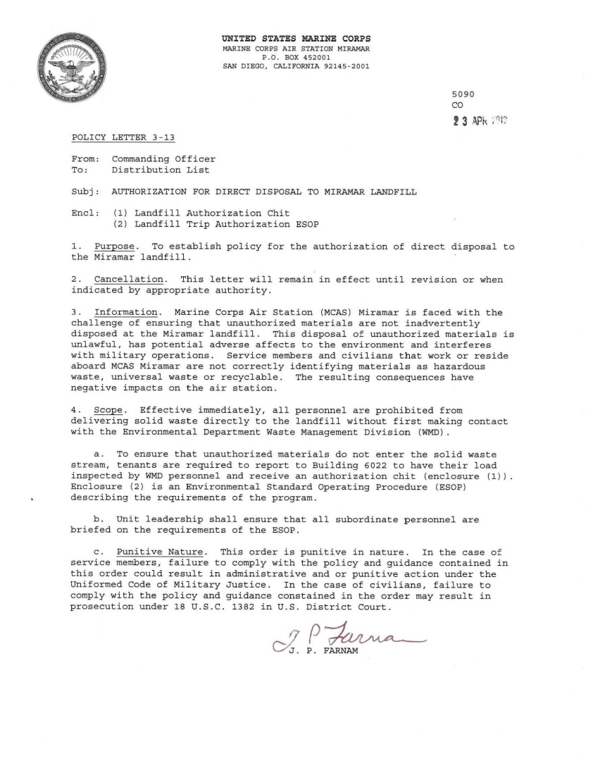
Policy Letter
3-13
-Signed by CO
Prohibits personnel from delivering solid waste to the landfill without contacting the WMD first.
The Miramar Landfill will reject your load if not accompanied by a WMD signed Landfill chit.

Slide 27
Ensure all personnel are briefed on the Landfill Trip Authorization ESOP.

Slide 28
Page 2 of ESOP discusses the Landfill chit form and prohibited items from the Landfill, Documentation, Record Keeping and Training.

Slide 29
CO’S ENVIRONMENTAL
POLICY STATEMENT

Slide 30

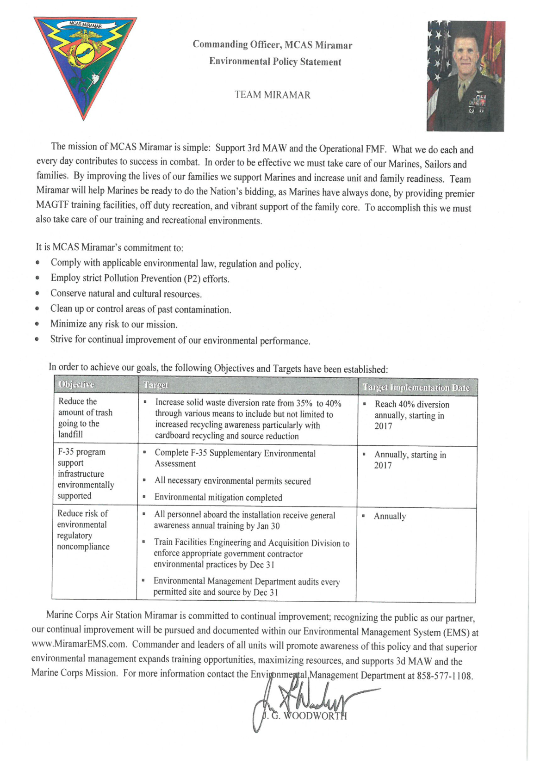
CO’S
ENVIRONMENTAL
POLICY
STATEMENT
Comply with
  applicable environmental law, regulation and policy.
Employ strict Pollution Prevention (P2) efforts.
Conserve natural and cultural resources.
Clean up past contamination.
Minimize any risk to our mission.
Continually improve our environmental performance.

Slide 31
The end

